Slide 1
Scout Recruitment In a COVID-19 World
Ideas for recruiting new scouts and engaging current scouts back into the Pack amidst a global pandemic.

Slide 2
Start NOW!!
Do not wait
for things to
‘Get Better’

Slide 3
Start NOW!!
If scouts aren’t engaged in the
program when the weather is nice,
they won’t be interested when the days get shorter and weather becomes a factor.

Slide 4
Start NOW!!
This goes for
both new
and
existing scouts.

Slide 5
Be A Scout Website
Make sure that your UNIT PIN
is updated and current.
My.scouting.org

Slide 6
Notes:
Go to ‘Organization Manager’ on my.scouting.org
Select the UNIT PIN

Slide 7
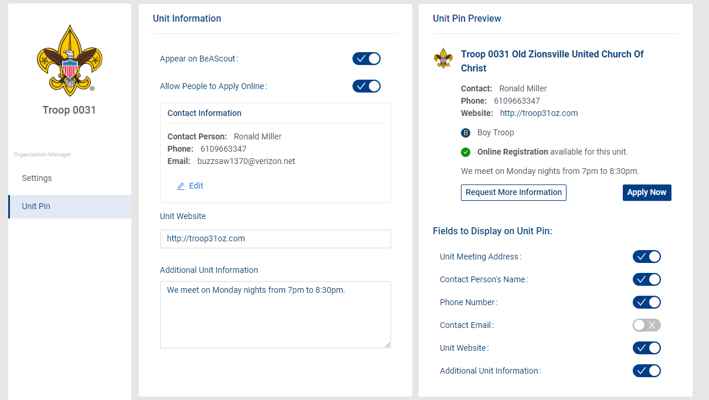
Notes:
Make sure that ‘Appear on BeAScout’ is checked off
Make sure that ‘Allow People to Apply Online’ is checked off.

Slide 8
Be A Scout Website
Only BSA membership dues are collected via website.
Any additional Unit Dues will need to be handled by the unit.
Notes:
This will allow them to join the BSA through the website, but they will only be able to pay for BSA dues and Boys’ Life. You will still need to collect any unit dues.

Slide 9
Be A Scout Website
18049

Slide 10
Be A Scout Website
18049
Notes:
Parents can click the APPLY NOW button and start the process.

Slide 11
Be A Scout Website
18049
Notes:
Made using FLOWCODE
Free
I went to BEASCOUT.ORG and entered my zip code
I saved the web address and used it while making the flowcode

Slide 12
Recruiting Events
Family Fun Day
Outdoor Venue
Non-Contact Games / Activities
Collect contact information &
provide directions for registration
Notes:
Find a good location where people can spread out
Find good games or activities that the scouts can participate in. Leave personal opinions about masks and social distancing at home. The state, Minsi Trails Council, and the BSA require us to adhere to local policies.
Promote the event through existing scouts, scout families, community pages, geo-fencing, and signage
Always try to get contact information from everyone and plan to follow-up with them the following week.

Slide 13
Recruiting Events
‘Rally Style’ Sign-Up Event
Secure a Location
Promote the Event
Collect contact information &
provide directions for registration
Notes:
A prominent park or location in your community. (Emmaus Triangle is centrally located and highly visible) Find a good location where people can spread out.
Have flags, signs, and banners out so that people know who you are!! Scouts in uniform is always a nice touch for this type of event.
Leave personal opinions about masks and social distancing at home. The state, Minsi Trails Council, and the BSA require us to adhere to local policies.
Promote the event through existing scouts, scout families, community pages, geo-fencing, and signage
Always try to get contact information from everyone and plan to follow-up with them the following week.

Slide 14
Virtual Recruiting Event
Invite people from your community
Get scouts and families to invite a friend
Prepare a collection of photos from previous events so that future scouts can get a feel for what the unit does

Slide 15
After Your Recruiting Event…
Have something planned to
‘kick things off’
What comes after registration?
How will the unit be meeting?
You’ve already talked to the Charter Organization, right?

Slide 16
Everyone is tired of living inside our boxes.
Think outside the box

Slide 17
Thank you and Good Luck

